Slide 1
ACCIDENT DATA ANALYSIS:
Introduction
The Fatal Accidents 2007 dataset consists all fatal accidents on public roads reported to the national highway transportation safety administration. I am using R for analyzing dataset by using different graphical interpretations and prediction model to find the solutions for the following research questions.
Fatalities by month, day of week, hour, state
Crash counts by Roadway function class, Route, Relation to road, Speed limit, light conditions, 3.Pedestrians involved in accident, Number of hit and run cases in accidents
Which type of accidents are more frequent in different road types
Accidents by alignment and number of lanes, Surrounding conditions and traffic controls functioning, weather conditions and roadway traffic flow.
Predict fatalities by different characteristic of accident data.
Dataset
The Fatality Analysis Reporting System (FARS) contains data on all vehicle crashes in the United States that occur on a public roadway and involve a fatality. The Fatal accident dataset downloaded from https://wiki.csc.calpoly.edu/datasets/wiki/HighwayAccidents. It has 32248 instances and 55 attributes. I used 25 variables.
ACCIDENT2007-FullD
ataSet.csv
1.STATE: State in U.S 2.MONTH: Month of the year
HOUR: Hour of the day
VE_TOTAL: Vehicles involved in accident
PERSONS: Persons involved in accident
PEDS: Persons which are not occupants of motor vehicle involved in accident
ROAD_FNC: Function class of road
ROUTE: Route Type 9.MAN_COLL: Manner of collision 10.REL_ROAD: Relation to road 11.TRAF_FLO: Traffic way flow
12. NO_LANES: Number of lanes 13.SP_LIMIT: Speed limit 14.ALIGNMENT: Road way alignment 15.PAVE_TYP: Road way surface type
16:SUR_COND:Road way surrounding conditions

Slide 2
17:T_CONT_F: Traffic controls functioning 18.HIT_RUN: Hit and run
19:LGT_COND: Light condition 20:WEATHER1: Weather condition.
21:C_M_ZONE: Construction and maintenance zone 22:SCH_BUS: School bus related vehicle
23:FATALS: Number of fatalities 24:DAY_WEEK: Day of week 25:DRUNK_DR: drunk and driver
Approach
DATA CLEANING
CREATING PLOTS
PERFORM REGRESSION ANALYSIS AND CONCLUSION
Step 1: Data cleaning:
Created a subset with variables using for this project. Creating factors of variable and removing the unknown and null values.
Step 2: Creating plots:
Generating plots by using ggplot2 library.
Step 3: Perform Regression analysis:
Selecting best subset of variables to perform regression analysis by using regularized linear
regression method. Split data into two parts train and test. Creating multivariate regression model by using train data set and test this model with test dataset and finally conclusion.

Slide 3
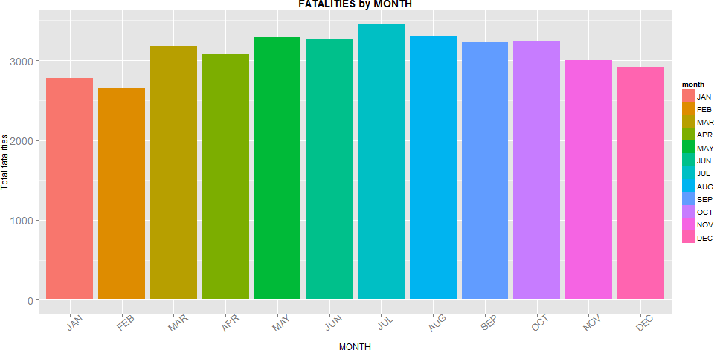
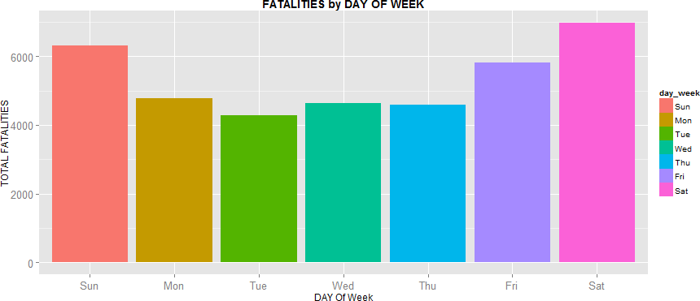
RESULTS:
1.Which month of year have highest fatalities?
Summary of Month Variable:
JAN FEB MAR APR MAY JUN JUL AUG SEP OCT NOV DEC 2493 2384 2855 2780 2992 2960 3142 2996 2910 2985 2732 2623
Fatalities are more in July. BY seeing this we can say accidents are more in summer than winter.
2.Which Day of week have highest fatalities
Summary of DAYOFWEEK Variable:
Sun Mon Tue Wed Thu Fri Sat 5617 4355 3953 4225 4206 5243 6253
Fatalities are more in Saturday, Sunday, Friday. Accidents are more in Weekends.

Slide 4
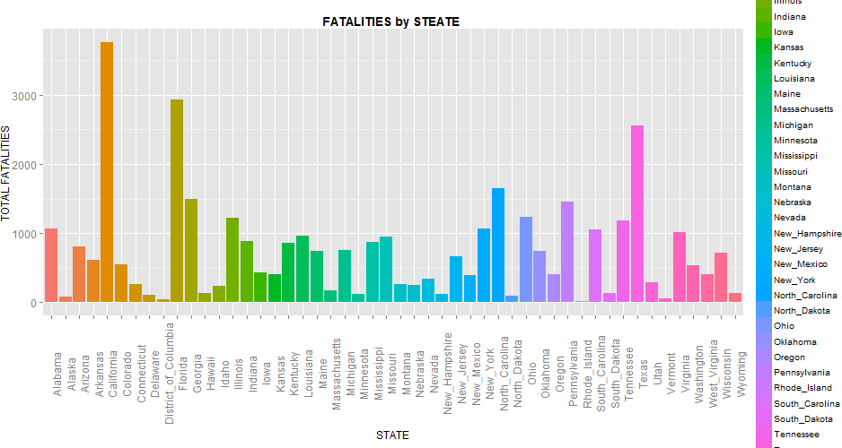
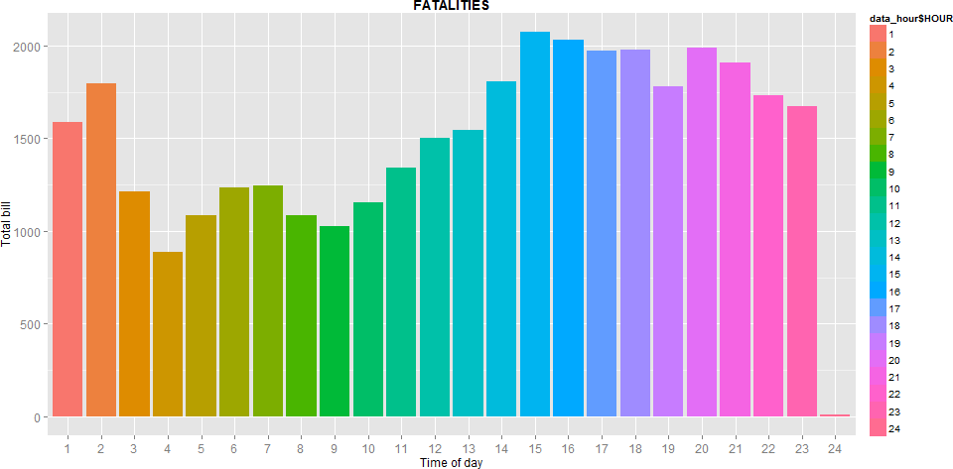
3.Which state of U.S have highest fatalities?
From this we can see California, Florida and Texas has highest fatalities.
4.Which Hour of day has highest fatalities?
From this we can say accidents are more in evenings and less in morning.

Slide 5
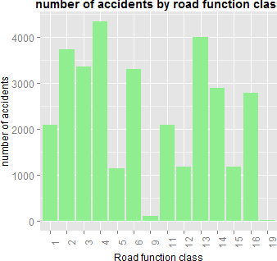
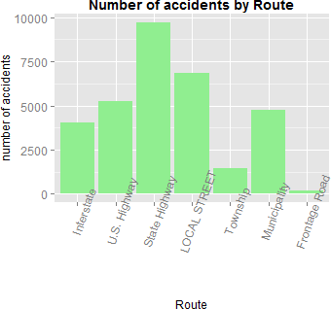
5.Number of accidents by road function class
Rural Principal Arterial- Interstate
Rural Principal Arterial-Other 3.Rural Minor Arterial
4.Rural Major Collector 5.Rural Minor Collector 6.Rural Local Road or Street 9.Rural Unknown
Urban Principal Arterial - Interstate
Urban Principal Arterial -
Other Freeways or Expressways 13.Urban Other Principal Arterial
14.Urban Minor Arterial 15.Urban Collector
16.Urban Local Road or Street 19-Urban Unknown
Accidents are more in Rural Major collector, Urban Other Principal Arterial, Rural Principal Arterial- Other, Rural Minor Arterial, Rural Local Road or Street, Urban Other Principal Arterial, Urban Minor Arterial, Urban Local Road or Street.
6.Number of accidents by Route:
Accidents are more in State Highways

Slide 6
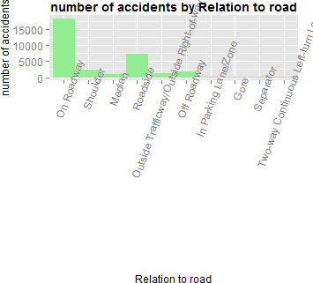
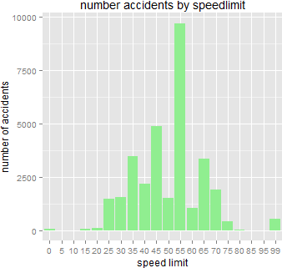
7.Number of accidents by relation to road:
Accidents are more in On Roadway
8.Number of accidents by speed limit:
Accidents are more at 55 speed limit

Slide 7
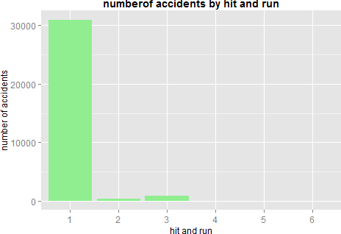
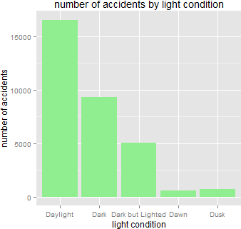
9.Number of hit and run in accidents:
1.No Hit-and-Run 2.Hit Motor Vehicle 3.Hit Pedestrian 4.Hit Parked Vehicle
Driver Leaves Scene after Non- Collision Event
Hit-and-Run, Other Involved Person Left Scene
almost all accidents are not Hit and run cases .
10.Number of accidents by light condition:
Accidents are more in Daylight

Slide 8
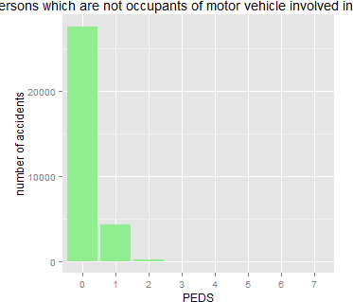
11. persons which are not occupants of motor vehicle involved in accident
Very less pedestrians involved in accidents.
12. which type of accidents are more frequent in different road types
PAVE_TYP
MAN_COLL |  |  |  | Concrete |  | Blacktop | Brick | Slag | Dirt
Not Collision | with | Motor | Vehicle | 1543 |  | 17172 | 6 | 330 | 176
Front-to-Rear |  |  |  | 349 |  | 1704 | 0 | 1 | 1
Front-to-Front |  |  |  | 213 |  | 3224 | 0 | 15 | 15
Front-to-Side, Same Direction |  |  |  |  | 51 | 378 | 0 | 1 | 0
Front-to-Side, Opposite Direction |  |  |  |  | 128 | 1510 | 0 | 3 | 3
Front-to-Side, Right Angle |  |  |  |  | 379 | 3923 | 0 | 36 | 6
Front-to-Side/Angle-Direction Not |  |  |  | Specified | 2 | 123 | 0 | 0 | 1
Sideswipe - Same Direction |  |  |  |  | 64 | 365 | 0 | 0 | 0
Sideswipe - Opposite Direction |  |  |  |  | 20 | 375 | 0 | 0 | 0
Rear-to-Side |  |  |  |  | 11 | 54 | 0 | 0 | 0
Rear-to-Rear |  |  |  |  | 1 | 1 | 0 | 0 | 0
End-Swipes and Others |  |  |  |  | 6 | 53 | 0 | 1 | 2
This is significant because p value is less than 0.05
Pearson's Chi-squared test data: tbl
X-squared = 465.01, df = 44, p-value < 2.2e-16

Slide 9
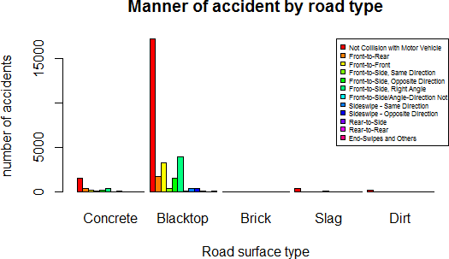
Accidents are more in Blacktop road surface. More accidents are not collision with motor vehicle and front to side(right angle),Front to Front collisions are more.
13.Accidents by alignment and number of lanes: no. of lanes
alignment | Straight | Curved
1 | 174 | 283
2 | 16673 | 7609
3 | 1941 | 379
4 | 3435 | 611
5 | 451 | 64
6 | 445 | 28
7 | 136 | 17
Chi-square | test:
Pearson's Chi-squared test
data: tbl
X-squared = 1086, df = 6, p-value < 2.2e-16

Slide 10
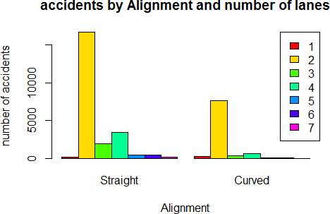
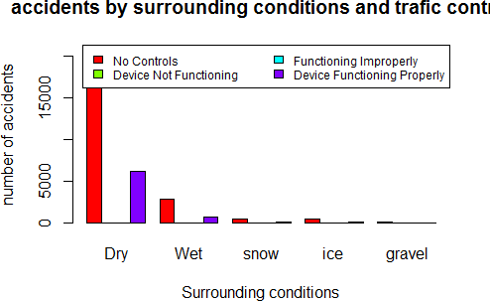
Accidents are more in straight single lane and curved double lanes roads.
14. Accidents by surrounding conditions and traffic controls functioning.
T_CONT_F
SUR_COND | Dry | Wet | snow | ice | gravel
No Controls | 21249 | 2881 | 502 | 443 | 52
Device Not Functioning | 20 | 4 | 1 | 0 | 0
Functioning Improperly | 21 | 2 | 0 | 0 | 0
Device Functioning Properly | 6209 | 746 | 65 | 42 | 9
chi-square test:
Pearson's Chi-squared test
data: tbl
X-squared = 102.09, df = 12, p-value < 2.2e-16
Accidents are more in Dry with no traffic signals.

Slide 11
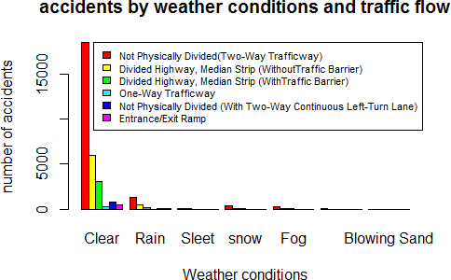
15. accidents by weather conditions and traffic flow
 | TRAFFIC FLOW
WEATHER1 | Clear | Rain | Sleet | snow | Fog | Severe Crosswinds | Blowing Sand
Not Physically Divided(Two-Way Trafficway) | 18454 | 1316 | 67 | 416 | 247 | 46 | 10
Divided Highway, Median Strip (WithoutTraffic Barrier) | 6011 | 467 | 38 | 118 | 56 | 18 | 3
Divided Highway, Median Strip (WithTraffic Barrier) | 3062 | 193 | 15 | 41 | 35 | 4 | 0
One-Way Trafficway | 244 | 15 | 0 | 0 | 1 | 0 | 1
Not Physically Divided (With Two-Way Continuous Left-Turn Lane) | 802 | 54 | 2 | 4 | 11 | 1 | 0
Entrance/Exit Ramp | 454 | 31 | 0 | 1 | 7 | 1 | 0
Pearson's Chi-squared test
data: tbl
X-squared = 71.948, df = 30, p-value = 2.65e-05
Accidents are more in clear weather and not physically divided Two way traffic ways.

Slide 12
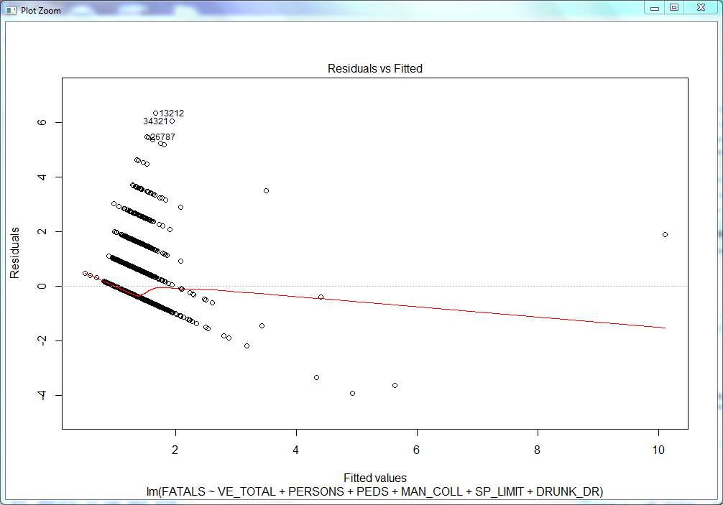
16.Predict fatalities:
Summary of prediction meodel:
Call:
lm(formula = FATALS ~ VE_TOTAL + PERSONS + PEDS + MAN_COLL +
SP_LIMIT + DRUNK_DR, data = train)
Residuals:
Min 1Q | Median | 3Q | Max
-3.7043 -0.1303 | -0.0558 | -0.0085 | 6.3945
Coefficients: | Estimate | Std. Error | t value | Pr(>|t|)
(Intercept) | 0.898720 | 0.010282 | 87.411 | < 2e-16 | ***
VE_TOTAL | -0.042630 | 0.004519 | -9.434 | < 2e-16 | ***
PERSONS | 0.072018 | 0.001504 | 47.899 | < 2e-16 | ***
PEDS | -0.071628 | 0.006161 | -11.627 | < 2e-16 | ***
MAN_COLLFront-to-Rear | -0.026040 | 0.011301 | -2.304 | 0.02122 | *
MAN_COLLFront-to-Front | 0.098751 | 0.008949 | 11.035 | < 2e-16 | ***
MAN_COLLFront-to-Side,Same | Direction-0.018145 | 0.020733 | -0.875 | 0.38150
MAN_COLLFront-to-Side,Opposite Direction 0.034942 0.011652 |  |  | 2.999 | 0.00271 | **
MAN_COLLFront-to-Side, Right Angle -0.004556 0.008386 |  |  | -0.543 | 0.58688
MAN_COLLFront-to-Side/Angle-Direction Not Specified 0.048630 0.036771 |  |  | 1.322 | 0.18601
MAN_COLLSideswipe - Same Direction -0.059248 0.021057 |  |  | -2.814 | 0.00490 | **
MAN_COLLSideswipe-Opposite Direction-0.003122 0.021407 |  |  | -0.146 | 0.88404
MAN_COLLRear-to-Side 0.087553 0.054307 |  |  | 1.612 | 0.10693
MAN_COLLRear-to-Rear -0.181951 0.370102 |  |  | -0.492 | 0.62299
MAN_COLLEnd-Swipes and Others -0.033808 0.053262 |  |  | -0.635 | 0.52560
SP_LIMIT 0.001462 0.000166 |  |  | 8.811 | < 2e-16 | ***
DRUNK_DR 0.047311 0.003968 --- |  |  | 11.923 | < 2e-16 | ***
Signif. codes: 0 ‘***’ 0.001 ‘**’ 0.01 ‘*’ 0.05 ‘.’ 0.1 |  |  | ‘ ’ 1
Residual standard error: 0.3701 on 25779 degrees of freedom Multiple R-squared: 0.115, Adjusted R-squared: 0.1144 F-statistic: 209.3 on 16 and 25779 DF, p-value: < 2.2e-16

Slide 13
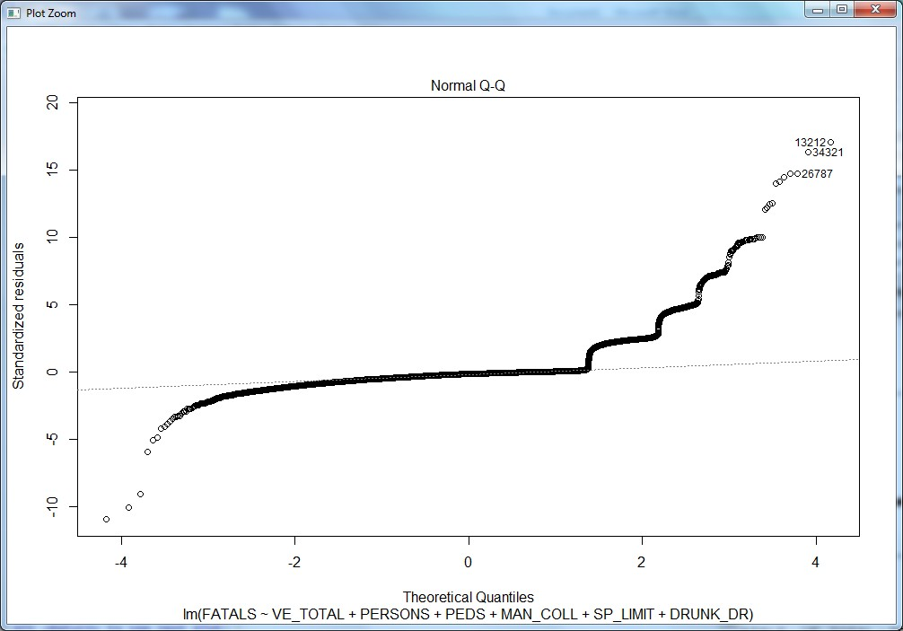
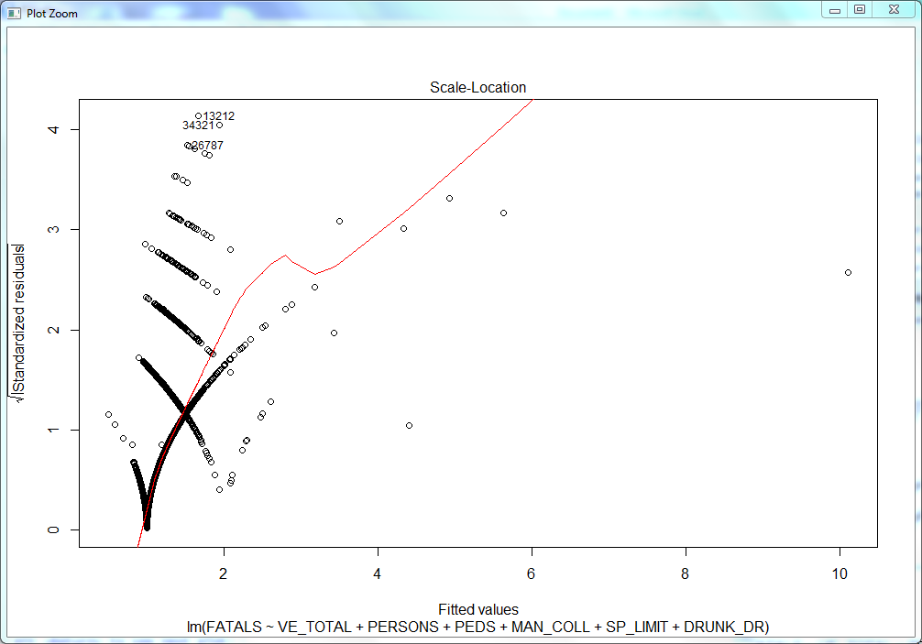

Slide 14
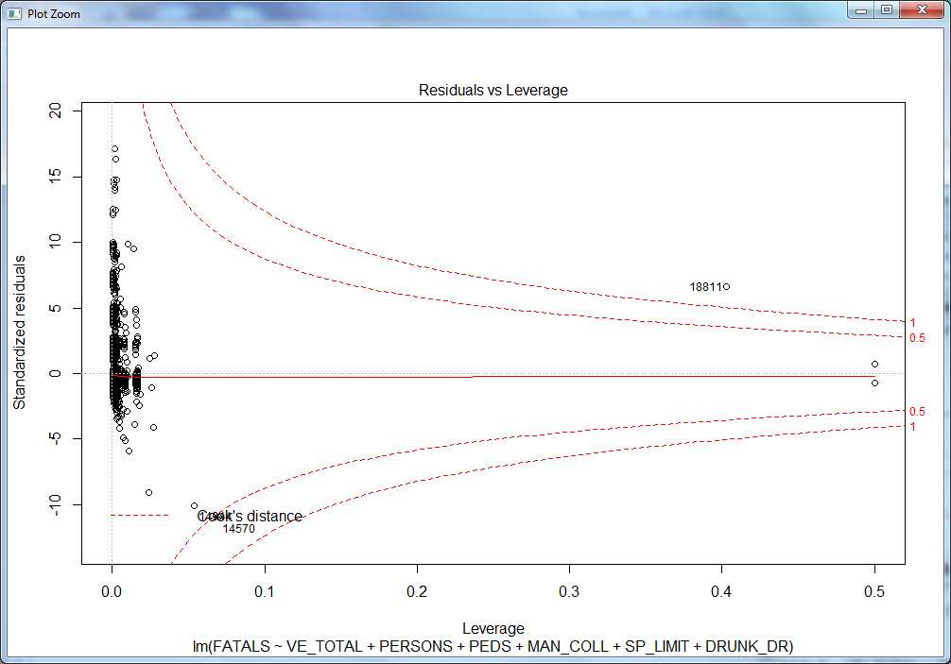
R Square of 13% percent suggests that Number of fatalities shows 13% of Variance explained by the Linear Model.
Intercept suggests if there are no accidents, fatality is 0.877, hypothetically wrong. But for any accident within specified conditions, fatality sums up by 0.877.
From the Coefficients, it depicts that -ve coefficients indicate that fatalities will be less when coefficients are -ve fatalities increases with higher +ve coefficients.
For eg: Front to rear collision decreases the changes of fatalities by 0.034.
Front to rear, Front to Side Same Direction, From to Side Right Angle, Sideswipe Opposite Direction has little effect on the number of fatalities and it decreases the effect of number of fatalities.
Rear to Rear accident has very less number of fatalities as explained by the coefficient at -0.38. As per regression model it has very less number of fatalities.
Every increase in pedestrians, it decreases the number of fatalities by -0.06. Each vehicle involvement decreases the number of fatalities by 0.028. But these conditions as derived by linear regression model is not agreed to confirm that fatalities decreases by increase in pedestrians and number of vehicles.
These situations should sum up with different conditions.
Number of persons involved in an accident increases the fatality rate by 0.071.

Slide 15
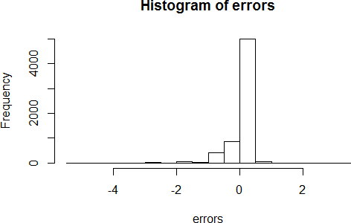
Front to Front, Front to side, rear to side increases the fatality rate.
Speed Limit and Drunken Drive will also increase the fatality rate.
RMSE:
sqrt(sum((prediction[,"fit"] - test$FATALS)^2)/nrow(test))
[1] 0.3742685
errors:
errors <- prediction[,"fit"] - test$FATALS hist(errors)
Histogram of errors:
relative change:
rel_change <- 1 - ((test$FATALS - abs(errors)) / test$FATALS) table(rel_change<0.10)["TRUE"] / nrow(test)
TRUE
0.5871318
Confusion matrix:
Reference
Prediction | 1 | 2 | 3 | 4 | 5 | 7 | 12
1 | 5909 | 437 | 75 | 21 | 6 | 1 | 1
2 | 0 | 0 | 0 | 0 | 0 | 0 | 0
3 | 0 | 0 | 0 | 0 | 0 | 0 | 0
4 | 0 | 0 | 0 | 0 | 0 | 0 | 0
5 | 0 | 0 | 0 | 0 | 0 | 0 | 0
7 | 0 | 0 | 0 | 0 | 0 | 0 | 0
12 | 0 | 0 | 0 | 0 | 0 | 0 | 0

Slide 16
Conclusion:
Based on theses analysis Fatalities are more in California , summer ,weekends, and evenings . accidents are more in Straight Rural Major collector with black top surface and not physically divided two way traffic Road at 55 speed limit with Clear daylight weather.
By taking precautions based on these analysis accidents may reduce. For example accidents are more in summer so drivers should be more careful in summer.
In some areas fatalities are more so if more fatalities occur they can send extra ambulance and increase the emergency services at that particular area and particular time.

